Slide 1
hello

Slide 2
about the class

Slide 3
goals
help you become the best programmer you can be
CS136 is the foundation for all the programming you will do after!
have fun
let’s code up some cool stuff from scratch!

Slide 4
what to expect
the lectures should make sense (especially on Monday)
if something doesn’t make sense, raise your hand!
the homework should take 10-15+ hours per week
if it’s too hard, let’s chat!--we will make a plan for success
“We don't all have the same floor or ceiling, but we each have a lot more in us than we know , and when it comes to [programming], everyone can achieve feats they once thought impossible. –David Goggins
if it’s too easy, do the challenge problem!—if that’s too easy, let’s chat!
“We’re either getting better or we’re getting worse.” –David Goggins
the exams should be challenging yet also completely unsurprising

Slide 5
week at a glance
👨‍🏫 Monday will be a lecture
often, i will explain a data structure
🧙 Wednesday will be a tutorial
often, we will implement a data structure together, step by step (bring your laptop!)
👨‍🔬 Thursday is lab
you work on the homework (definitely bring your laptop!)
🦉✨ Friday is time for Kahoot! and advanced topics
Kahoot’s are meant to prepare you for the exams’ shorter questions
advanced topics are meant to challenge and entertain you

Slide 6
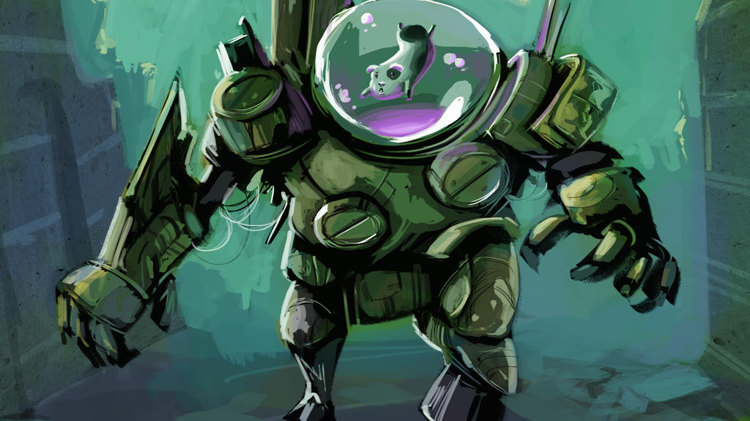
are you guinea pigs?
yes
however
1) guinea pigs are awesome, and
2) i am very excited to teach this course 🙂👍

Slide 7
difficulty, inclusivity, and programming and a lifetime of coding

Slide 8
how different are our backgrounds?
let’s find out!
what is an ArrayList?
what does mens rea mean?
what is the integral of x^2 + 5x?
what happened in Guatemala in 1954?
what does it mean to ”shower” in juggling?
what is the Nash Equilibium of the Prisoners’ Dilemna?
consider two cups that are just about to overflow with water. one also has some ice floating in it. which weighs more? why?
🗣️ is there anyone here who knows the answer to all the questions?
🗣️ is there any question that no one knows the answer to?

Slide 9
our backgrounds are very different...
...but my goal is for this class to be fun and accessible for everyone here
each week of lecture will follow an easy-to-hard difficulty ramp
Monday is easier
Wednesday is harder
Friday is hardest
each homework will follow an easy-to-hard difficulty ramp
B is easier
A is harder
S is hardest

Slide 10
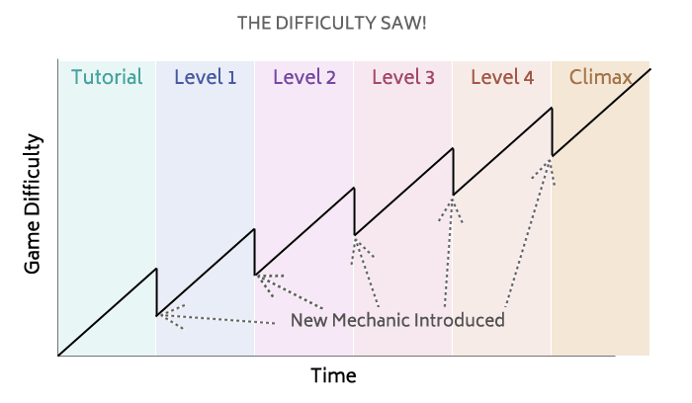
the course as a whole should follow a saw
http://www.davetech.co.uk/difficultycurves

Slide 11
there is no finish line
it’s 10+ years since i took the equivalent of CS 136
i still code almost every day
i still learn something new almost every day
i still feel like i have no idea what i’m doing almost every day

Slide 12
big O

Slide 13
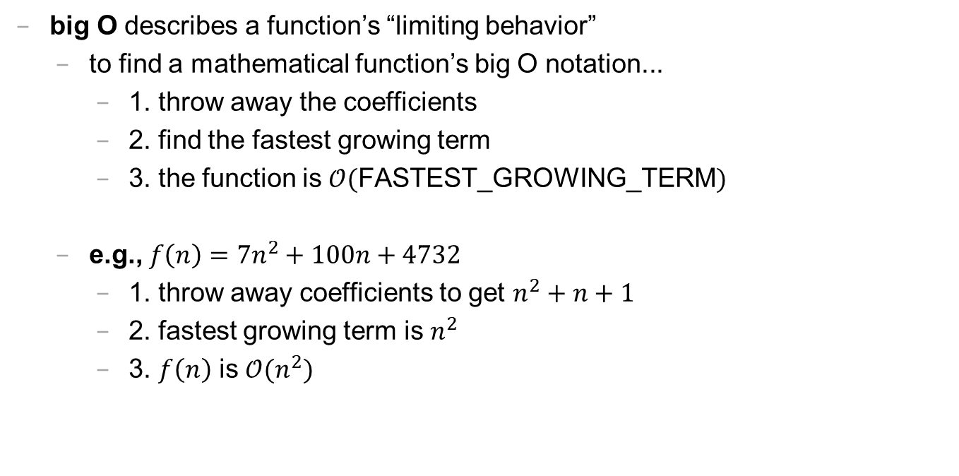
how to read/write big O notation
big O describes a function’s “limiting behavior”
to find a mathematical function’s big O notation...
1. throw away the coefficients
2. find the fastest growing term
3. the function is $𝒪($FASTEST_GROWING_TERM$)$
e.g., $f\left(n\right)=7n^{2}+100n+4732$
1. throw away coefficients to get $n^{2}+n+1$
2. fastest growing term is $n^{2}$
3. $f\left(n\right)$ is $𝒪(n^{2})$

Slide 14

how to read/write big O notation
e.g., what is $f\left(n\right)=77n^{7}+2^{n}$ in big O notation?
$n^{7}+2^{n}$
$2^{n}$ 🧪 is this true?
$𝒪(2^{n})$
e.g., what is $f\left(n\right)=100$ in big O notation?
$1$
$1$ 🧠 what does this mean?
$𝒪(1)$
e.g., what is $f\left(n\right)=n+log⁡(n)$ in big O notation?
$n+log⁡(n)$
$n$ 🧪 is this true?
$𝒪(n)$

Slide 15
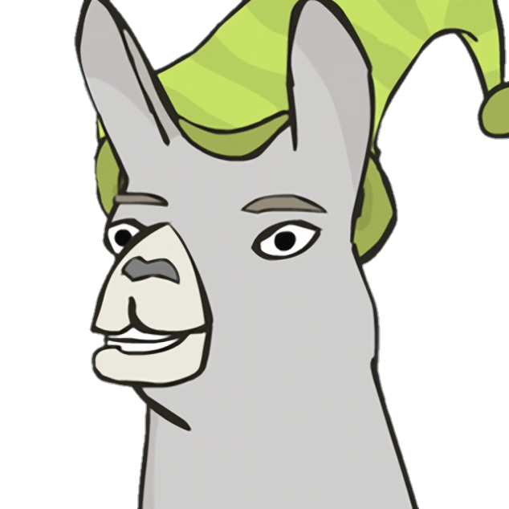
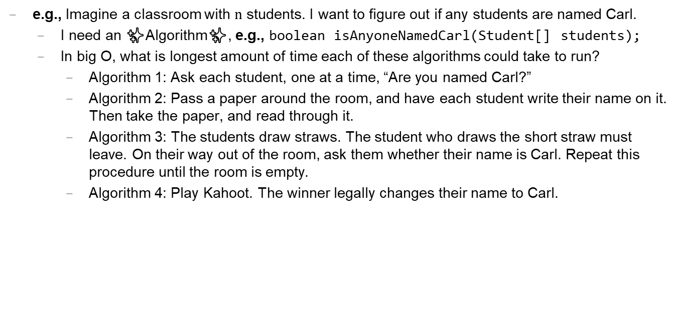
how to read/write big O notation
e.g., Imagine a classroom with $n$ students. I want to figure out if any students are named Carl.
I need an ✨Algorithm✨, e.g., boolean isAnyoneNamedCarl(Student[] students);
In big O, what is longest amount of time each of these algorithms could take to run?
Algorithm 1: Ask each student, one at a time, “Are you named Carl?”
Algorithm 2: Pass a paper around the room, and have each student write their name on it. Then take the paper, and read through it.
Algorithm 3: The students draw straws. The student who draws the short straw must leave. On their way out of the room, ask them whether their name is Carl. Repeat this procedure until the room is empty.
Algorithm 4: Play Kahoot. The winner legally changes their name to Carl.
Notes:
Algorithm 3: Ask all students at the same time to scream, “Carl!” if their name is Carl. Five seconds later return whether anyone screamed Carl.

Slide 16
Java primitive data types

Slide 17
most popular Java primitive data types

Slide 18
boolean, char, double, int
a boolean stores a truth value, e.g.,
true, false
a char stores a character, e.g.,
'\0', 'a', 'Z', '!'
a double stores a floating point number, e.g.,
0.0, -0.5, 3.1415926, Double.NEGATIVE_INFINITY
an int stores an integer number, e.g.,
0, -1, 4

Slide 19
primitive data type Venn diagram
integers
numbers
char
double
boolean
int

Slide 20
char is an integer type
a char is an integer type
each char has a corresponding integer, e.g., ('a' == 97)
the letters are in order, i.e., ('a' == 97), ('b' == 98), ('c' == 99)...
the numbers are also in order, i.e., ('0' == 48), ('1' == 49)...
you can do math with char's, e.g.,
char foo = 'a' + 2; // foo is 'c'
char bar = '0' + 7; // bar is '7'
int baz = '6' - '0'; // baz is 6

Slide 21
zero
each primitive data type has its own notion of what it means to "be zero"
int zero = 0;
double zero = 0.0;
boolean zero = false;
char zero = '\0'; // the "null character"

Slide 22
Java operators (except for bitwise operators, which we'll do later maybe)

Slide 23
assignment operator

Slide 24
assignment operator
= assigns the value on the right-hand side to the variable on the left-hand side, e.g.,
int i = 0; // 0 ("int i now has the value 0")
double foo = coolFunction();
☠ the assignment operator returns the value it assigned this is usually pretty confusing, e.g.,
int i = 4;
int j = (i *= 42);

Slide 25
arithmetic operators

Slide 26
basic arithmetic (number) operators
+ adds two numbers
- subtracts two numbers
* multiplies two numbers
/ divides two numbers
☠ an int divided by an int is an int, e.g.,
int foo = 8 / 2; // 4
int bar = 2 / 7; // 0
Java "throws away the remainder"
- returns the negative of a number, e.g.,
int bar = -7; // -7 ("negative 7")
int baz = -bar; // 7

Slide 27
modulo
x % N returns the remainder of x / N and is read "x modulo N," e.g.,
int foo = 17 % 5; // 2 ("17 divided by 5 is 3 remainder 2")
☠ % probably doesn't do what you expect for negative numbers
instead, use ((x % N + N) % N)

Slide 28
logical operators

Slide 29
logical operators
|| returns whether the left-hand side or the right-hand side is true
(true || true) // true
(true || false) // true
(false || true) // true
(false || false) // false
&& returns whether the left-hand side and the right-hand side are true
(true && true) // true
(true && false) // false
(false && true) // false
(false && false) // false
! returns the opposite of a boolean, and is read as "not"
(!true) // false ("not true")
(!false) // true

Slide 30
logical operators
// example, step by step
boolean a = (2 + 2 == 5); // false
boolean b = true; // true
boolean c = (a || b); // true
boolean d = !c; // false
// same thing all on one line
boolean d = !((2 + 2 == 5) || true); // false
// equivalent code
boolean d = false;

Slide 31
☠ logical operator short-circuiting
(false || foo()) "lazily" evaluates to false without evaluating foo()
(true && foo()) "lazily" evaluates to true without evaluating foo()

Slide 32
comparison operators

Slide 33
☠ equality (is equal to)
== returns whether the left-hand side is equal to the right-hand side, e.g.,
boolean b = (foo == bar);
if (foo == bar) { ... }
☠ this does NOT work for String's
instead, use (stringA.equals(stringB) )
☠ this does NOT work for double's
instead, use (Math.abs(double1 - double2) < 0.00001)

Slide 34
is greater than, is less than
> returns whether the left-hand side is greater than the right-hand side
< returns whether the left-hand side is less than the right-hand side

Slide 35
convenient operators (feel free to ignore these for now)

Slide 36
inequality
!= returns whether the left-hand side is not equal to the right-hand side
(left != right) is exactly the same as (!(left == right))

Slide 37
greater than or equal to, less than or equal to
>= returns whether the left-hand side is greater than or equal to the right-hand side
(left >= right) is basically the same as ((left > right) || (left == right)) greater-than or equal
<= returns whether the left-hand side is less than or equal to the right-hand side

Slide 38
arithmetic assignment operators
a += b; // a = a + b;
a -= b; // a = a - b;
a *= b; // a = a * b;
a /= b; // a = a / b;

Slide 39
String concatenation
+ concatenates two String's, e.g.,
// String foo = "Hello".concat("World"); String foo = "Hello" + "World"; // "HelloWorld"
// String foo = "Hello".concat(Integer.toString(2)); String foo = "Hello" + 2; // "Hello2"

Slide 40
increment operator
to "increment" means to increase the value of a number by one, e.g.,
i = i + 1;
i += 1;
the pre-increment ++i increments i and returns the new value of i
j = ++i; // i = i + 1;
// j = i;
the post-increment i++ increments i and returns the old value of i
j = i++; // j = i;
// i = i + 1;

Slide 41
decrement operator
to "decrement" means to decrease the value of a number by one, e.g.,
i = i - 1;
i -= 1;
the pre-decrement --i decrements i and returns the new value of i
j = --i; // i = i - 1;
// j = i;
the post-decrement i-- decrements i and returns the old value of i
j = i--; // j = i;
// i = i - 1;

Slide 42
examples

Slide 43
// return whether n is prime
boolean isPrime(int n) { for (int i = 0; i < n; ++i) { if (n % i == 0) { return false; } } return true; }

Slide 44
returns the index of the maximum element in an array e.g., when called on { 0.0, 4.2, -10.0, 99.0 }, returns 3 when called on {}, returns -1
int findIndexOfMaxElement(double[] array) { int result = -1; double maxElementFoundSoFar = Double.NEGATIVE_INFINITY; for (int i = 0; i < array.length; ++i) { if (array[i] > maxElementFoundSoFar) { result = i; maxElementFoundSoFar = array[i]; } } return result; }
returns the number of digits an integer has (in base-10) e.g., when called on 427, returns 3
int getNumberOfDigits(int n) { int result = 0; while (n != 0) { ++result; // result = result + 1; n /= 10; // n = n / 10; } return result; }
print ☺☻♥♦♣ ♫☼►◄↕‼¶§▬↨↑↓→←∟↔▲▼ !"#$%&'()*+,-./0123456789:;<=>?@ABCDEFGHIJKLMNOPQRSTUVWXYZ[\]^_`abcdefghijklmnopqrstuvwxyz{|}~⌂
for (char c = 0; c < 128; ++c) { System.out.print(c); }
TODO: modding by length of array

Slide 45

arrays

Slide 46
array
an array is
int[] foo;
double[] baz;
String[] bar;

Slide 47

accessing an array
⏱️ accessing an array is $𝒪(1)$
i.e., "accessing an array takes a constant number of CPU cycles"
getting the value of array’s i-th element
int currentValue = array[i];
setting the value of array’s i-th element
array[i] = newValue;

Slide 48

creating an array
⏱️ creating an array is $𝒪(n)$
creating a new integer array with 7 elements
int[] array = new int[7];
creating a new String array with n elements
String[] array = new String[n];

Slide 49
while
a while loop repeats a block of code

Slide 50
while
while (true) { ... } is useful for prototyping

Slide 51
array list

Slide 52
TODO list
the list (aka sequence) abstract data type is
an array list's length is the number of elements stored inside it
an array list stores its elements inside of an array
i call this array the array list’s “internal array”
an array list's capacity is the length of this internal array

Slide 53
array list
the array list (aka dynamic array, stretchy buffer, vector) data structure implements the list abstract data type using an array
an array list's length is the number of elements stored inside it
an array list stores its elements inside of an array
i call this array the array list’s “internal array”
an array list's capacity is the length of this internal array

Slide 54
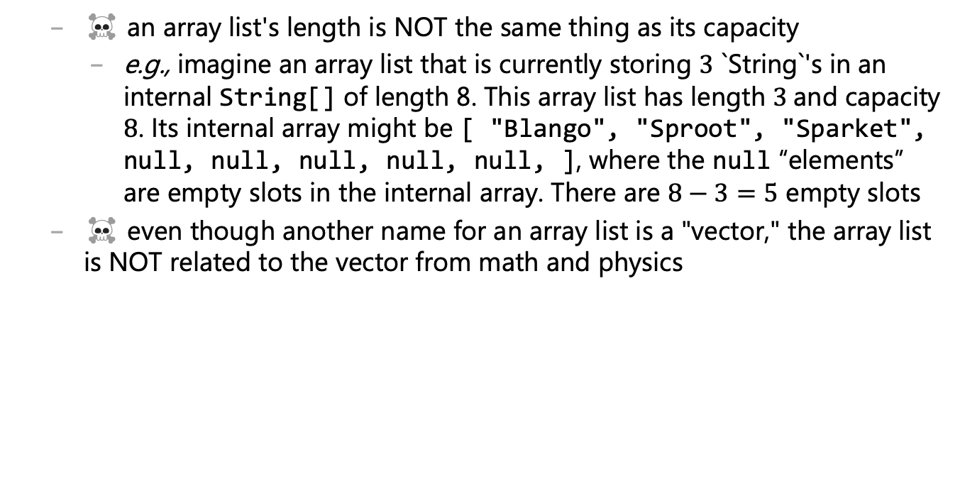
array list
☠️ an array list's length is NOT the same thing as its capacity
e.g., imagine an array list that is currently storing $3$ `String`'s in an internal String[] of length 8. This array list has length $3$and capacity $8$. Its internal array might be [ "Blango", "Sproot", "Sparket", null, null, null, null, null, ], where the null “elements” are empty slots in the internal array. There are $8−3=5$ empty slots
☠️ even though another name for an array list is a "vector," the array list is NOT related to the vector from math and physics

Slide 55

ArrayList() { ... }
a new array list should have...
length equal to $0$
internalArray equal to a new array with length equal to some starting capacity, e.g., $4$

Slide 56
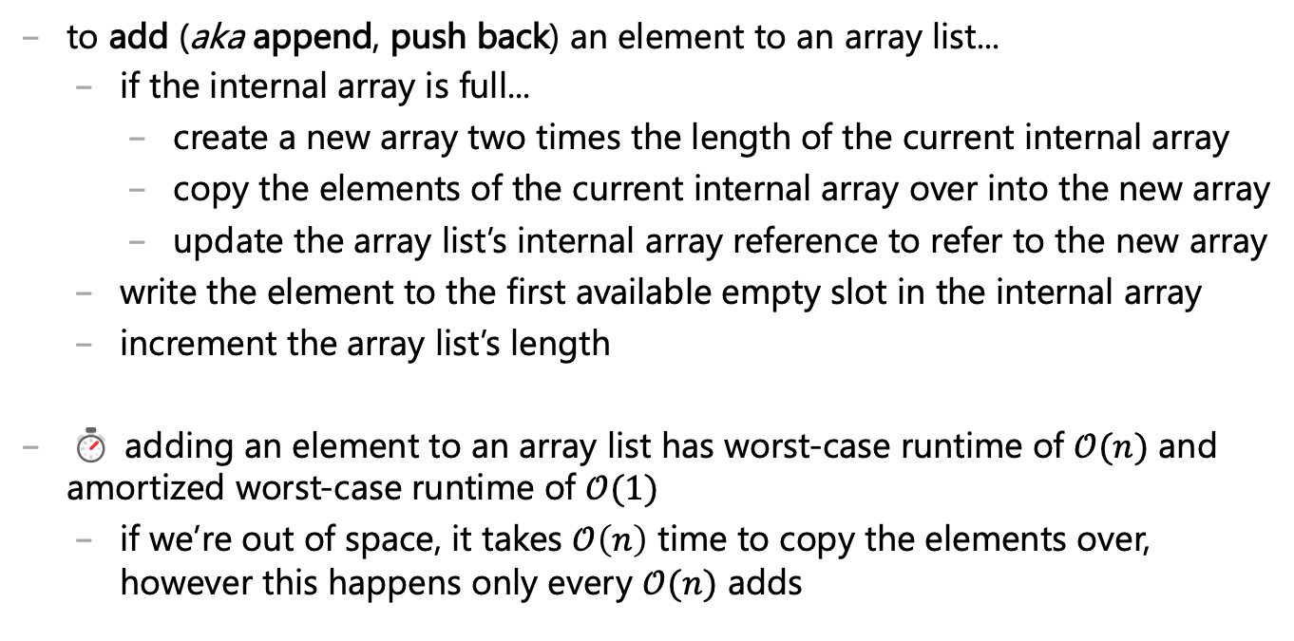
void add(ElementType element) { ... }
to add (aka append, push back) an element to an array list...
if the internal array is full...
create a new array two times the length of the current internal array
copy the elements of the current internal array over into the new array
update the array list’s internal array reference to refer to the new array
write the element to the first available empty slot in the internal array
i ncrement the array list’s length
⏱ adding an element to an array list has worst-case runtime of $𝒪(n)$ and amortized worst-case runtime of $𝒪(1)$
if we’re out of space, it takes $𝒪\left(n\right)$ time to copy the elements over, however this happens only every $𝒪(n)$ adds

Slide 58
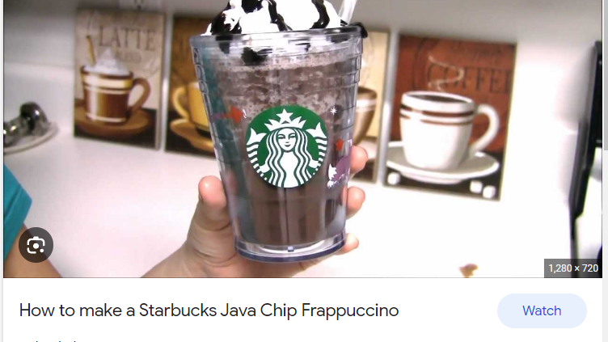
Java

Slide 59
primitives

Slide 60
operators

Slide 61
scope

Slide 62
scope
a scope is a region of code in which variables live
in Java, a scope is define by a pair of curly braces
OUTSIDE_SCOPE { INSIDE_SCOPE } OUTSIDE_SCOPE
remember, Java doesn't care about whitespace

Slide 63
whitespace
whitespace includes spaces and newlines
🐍 Python does care about whitespace (indentation changes what code does)
Java does NOT care about whitespace
🗣️ do you care about whitespace?
some guidelines:
be consistent!
carefully indent your scopes (and make sure your curly braces line up)
✨ your text editor can do this for you!
sparks joy | NOT equivalent -- doesn’t spark joy
for (int i = 0; i < 10; ++i) { if (i % 3 == 0) { System.out.println("fizz"); } } | for (int i = 0; i < 10; ++i) { if (i % 3 == 0) { } System.out.println("fizz"); }

Slide 64
about the lectures

Slide 65
🐮 how to read side by side code
i often show equivalent code side by side in order to...
relate new concepts to old concepts
compare and contrast different design decisions, e.g.,
a piece of code | equivalent code | equivalent code | equivalent code
boolean isEven; if (i % 2 == 0) { isEven = true; } else if (i % 2 != 0) { isEven = false; } if (isEven) { ... } | boolean isEven; if (i % 2 == 0) { isEven = true; } else { isEven = false; } if (isEven) { ... } | boolean isEven = (i % 2 == 0); if (isEven) { ... } | if (i % 2 == 0) { ... }

Slide 66
🐮 how to read emojis
i use emojis to help you read and study
🐮 info only relevant inside the world of CS136
☕ fun Java fact! (i.e., NOT relevant to C/C++; please forget after CS136)
🐍 comparison to Python
☠ common misconception or potential source of bugs
👀 spoilers/hints
⏱ big O runtime
✨ optional (NOT on exams) but sparks joy
🧠 question for you to think about
🗣️ question for your to talk about
🧪 question for you to experiment with
🙂👍

Slide 67
🐮 how to read emojis
🧠 what is code?
code tells a computer how to do something
🗣️ what makes code good?
good code makes your computer do the thing you want it to do, and...
runs fast
is small
is easy to read
🧪 make this code worse
Java code to make your computer print Hello World!
class HelloWorld { public static void main(String[] args) { System.out.println("Hello, World!"); } }

Slide 68
🧪
public class HelloWorld {public static void main(String[] args){ int[][] t = new int[][]{{202,1026,1100,396,324,1080,192,609,555,888,72,432}, {3,9,8,5},{2,2,5,9},{4,6,1,9,2,11},{4,6,1,9,3,2,11,7,0,5,10},{2,1,5,9},{1,9,2,5},{0,2,10,5,1,6,3,11,8,4},{10,4,2,6}, {1,10,2,3,5,9,7,4,11,6},{7,0,3,6},{2,9,10,1},{7,1,10,6},{12,0,-0}};do{while(t[13][1]+1<t[t[13][0]].length){ t[13][2]=t[0][t[t[13][0]][t[13][1]]];t[0][t[t[13][0]][t[13][1]]]=t[0][t[t[13][0]][++t[13][1]]];t[0][t[t[13][0]][t[13][1]++]]=t[13][2];} }while(!(--t[13][0]<=(int)Math.sin(Math.PI))&&((t[13][1]=0)<1));while(t[4][2]<=t[9][5]+3)System.out.print((char)(t[0][t[4][2]-1]/t[4][2]++));}}

Slide 69
🐮 how to read a step-by-step diff?
to show you the step-by-step process by which i write code, i will use something called a diff, which shows us the “difference” between two files
i will basically always be diffing the code at the current step with the code at the previous step, i.e.,
+ this line of code was just added - this line of code was just deleted this line of code was here last step and is still here now

